Slide 1
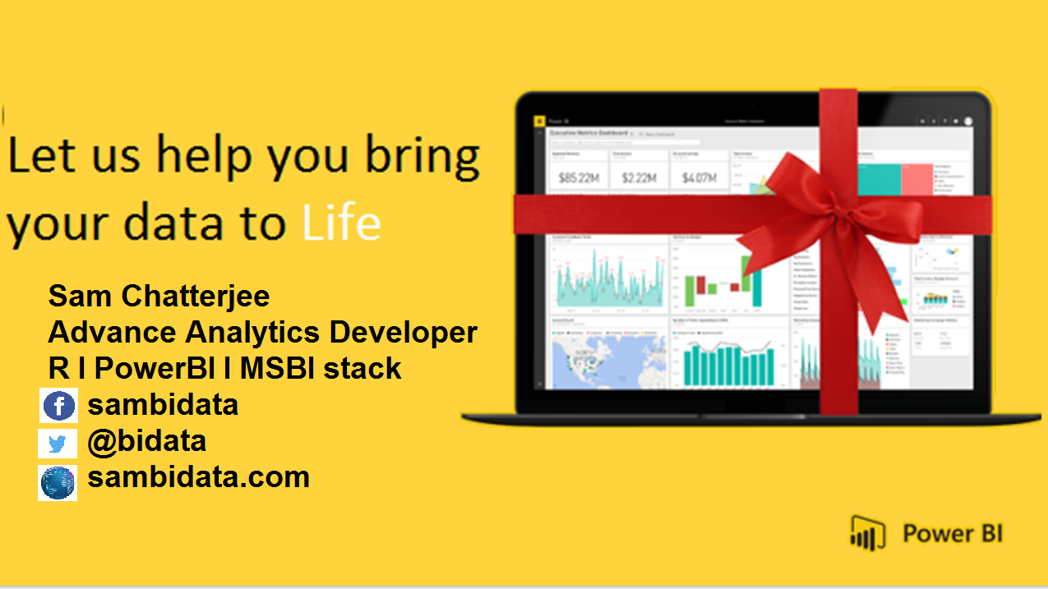

Slide 2
Agenda
REPORTS AND THE BEST PRACTICES!
Report design
Visuals design

Slide 3
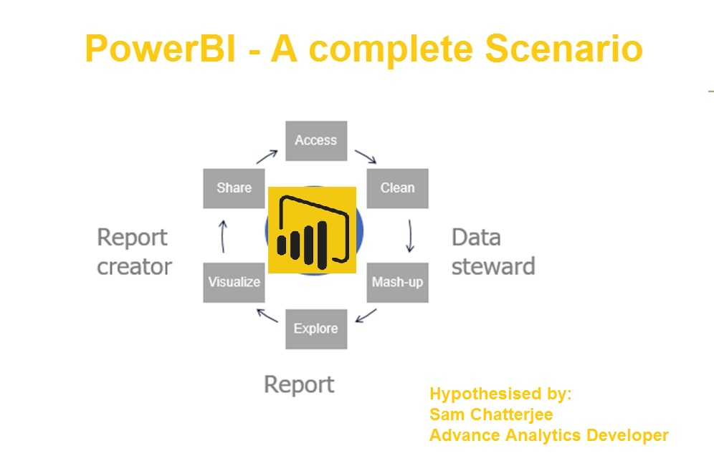


Slide 4
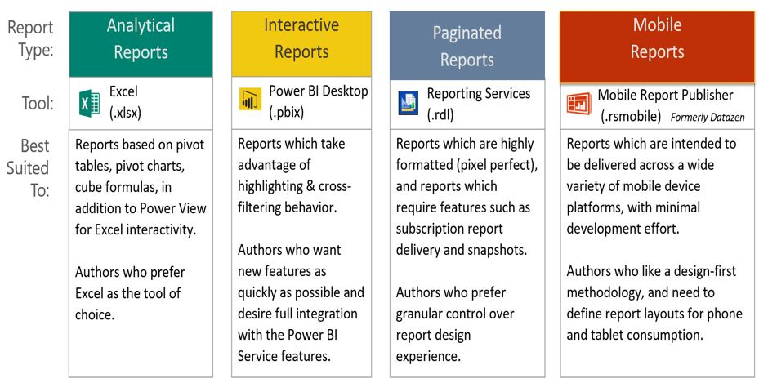
TYPES OF REPORTS

Slide 5
Principles of designing reports
Alignment
Order
Proximity

Slide 6
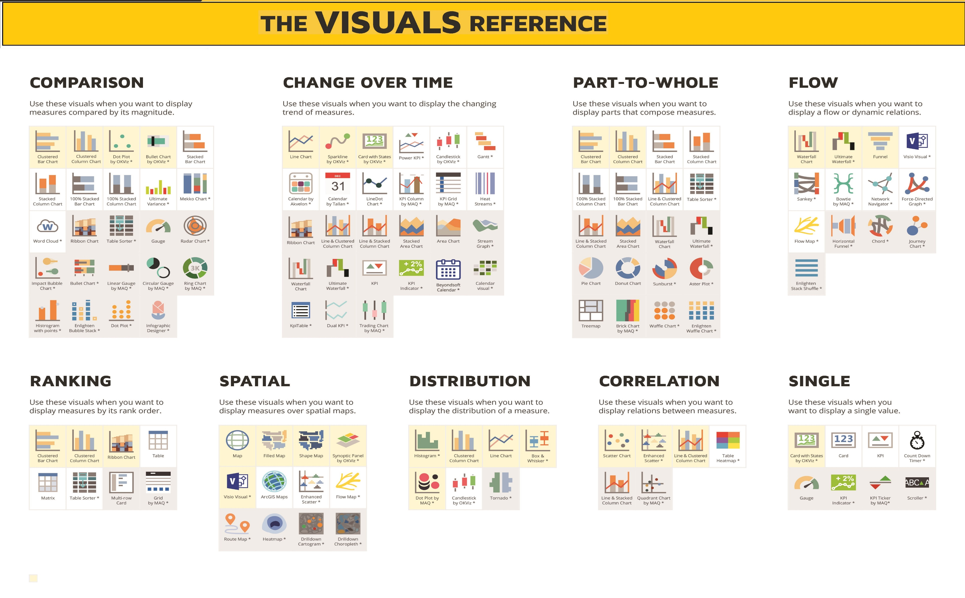

Slide 7
Principles of designing reports
Keep a structure of report pages
Make report content easy to read
Element that requires users to make choices should be placed in the left part of the report assuming you read from left to right
Related elements should be close to each other
Use borders or colors to create sections
Avoid extra white space – make visualizations larger og canvas smaller
Consider size of visualizations – important elements should be larger

Slide 8
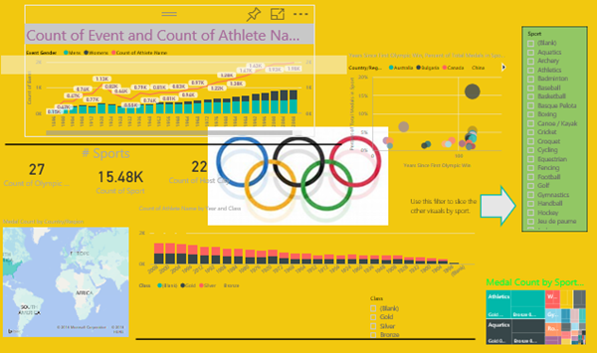
Principles of designing reports

Slide 9
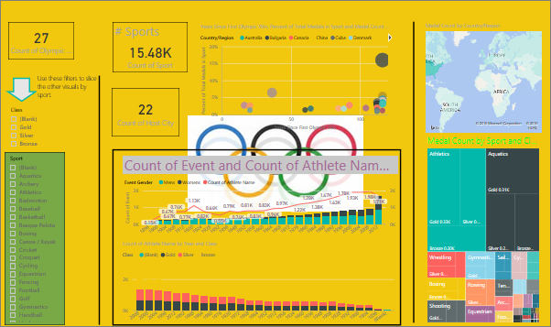
Keep a structure of report pages

Slide 10
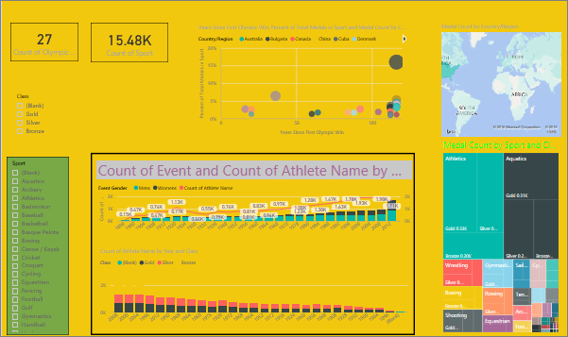
Make report content easy to read

Slide 11
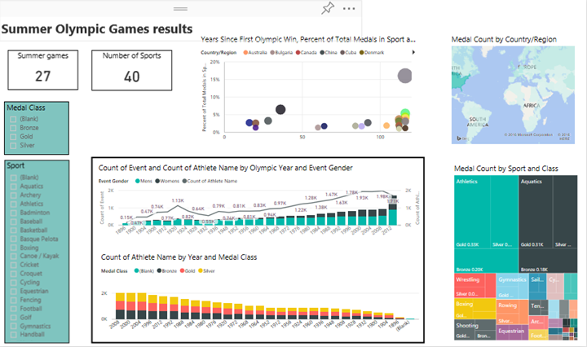
Use borders or colors to create sections

Slide 12
Principles of designing visuals
Choose the right visualizations
Keep it simple
Use relevant measures

Slide 13
Principles of designing visuals
Experiment with different types of visuals
Avoid scrolling, use hierachies and drilldown
Use text elements, e.g. text boxes and titles
Be aware of axis and scaling
Remove irrelevant text and align relevant text
Decide on visual interactions
Use colors

Slide 14
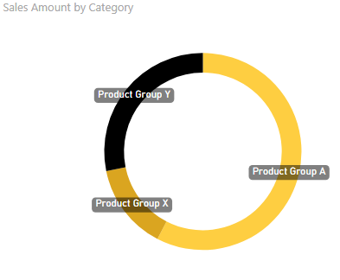
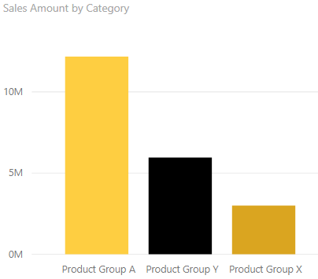
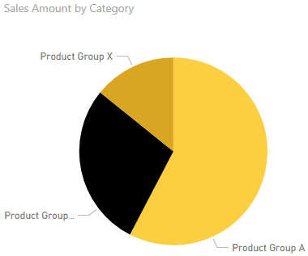
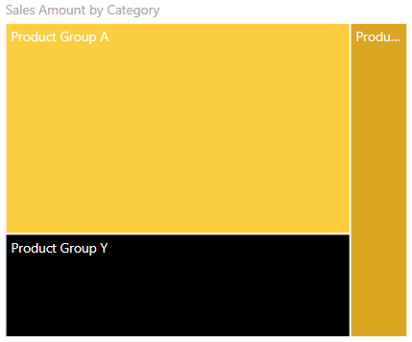
Experiment with different types of visuals

Slide 15
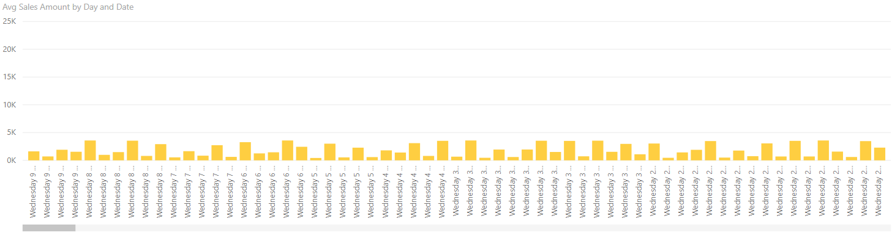
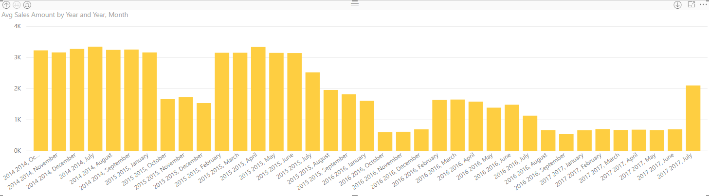
Avoid scrolling, use hierachies and drilldown

Slide 16
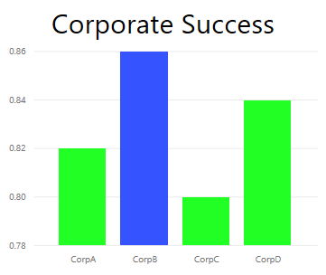
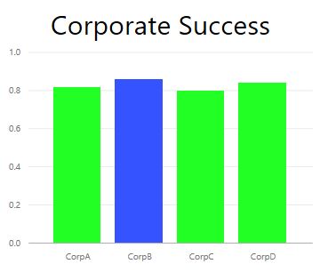
Be aware of axis and scaling

Slide 17
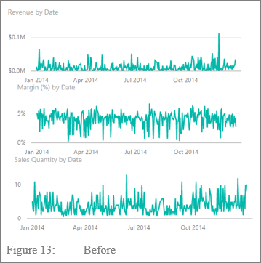
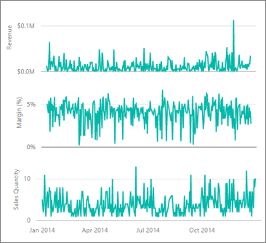
Remove irrelevant text and align relevant text

Slide 18
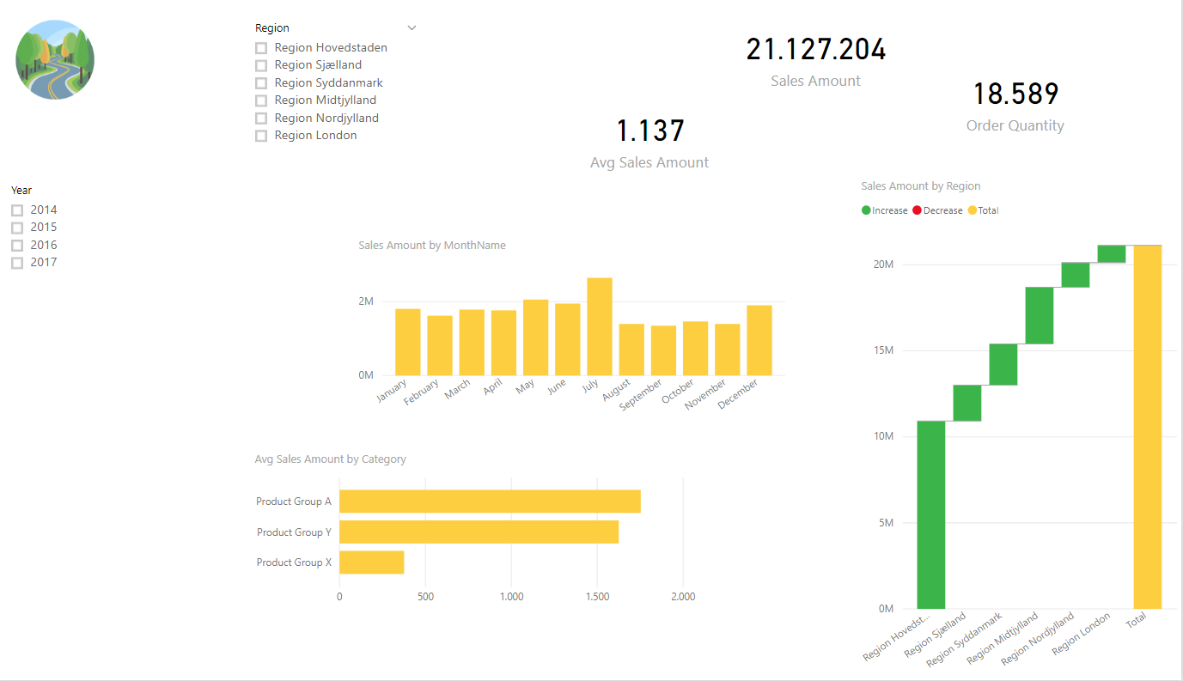
Demo – from draft

Slide 19
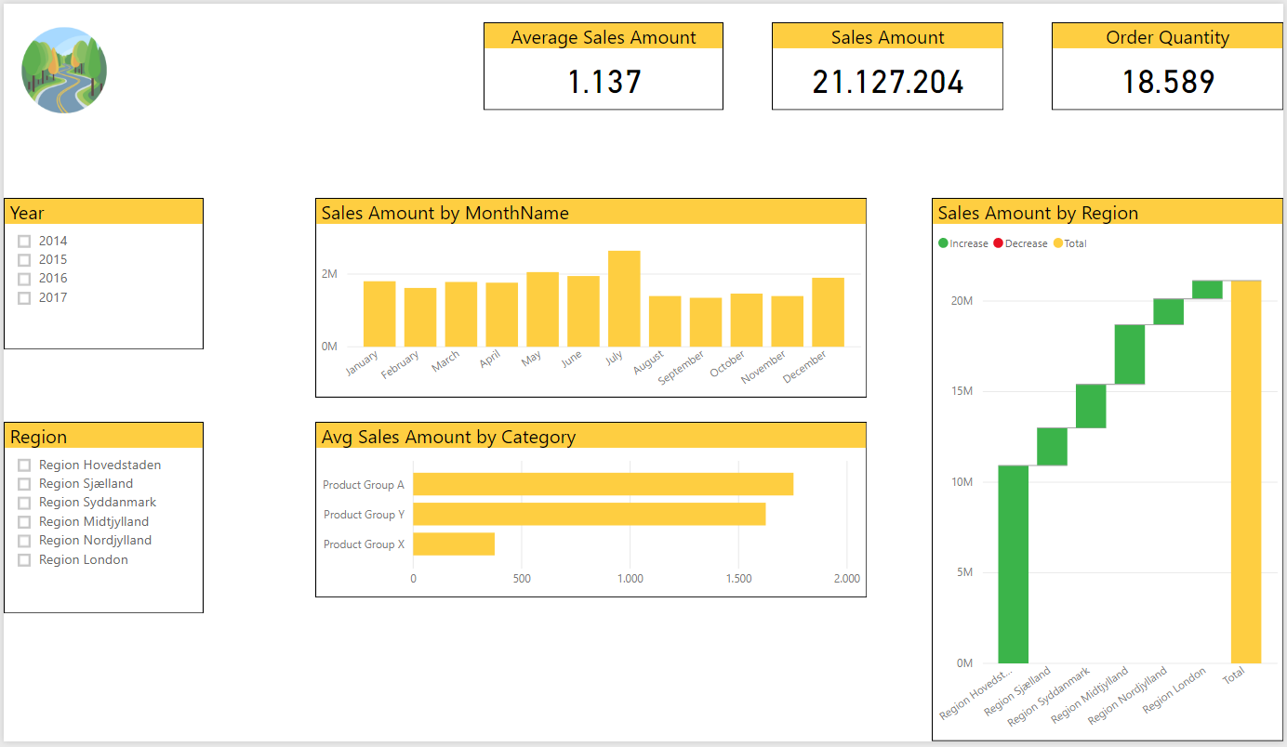
Demo – to final

Slide 20
Tricks
Align elements
Distribute elements
Bulk-format same visualization types
Show Gridlines and General formatting section
Search in formatting settings

Slide 21


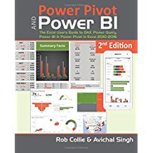

Resources
Get Power BI (Free) http://tinyurl.com/hj5hdg6
Power BI Jump Start http://bit.ly/1ktON16
Power BI Getting Started http://bit.ly/1FF88KA
Power BI Team Blog http://bit.ly/1vwbTLG
Power BI Channel 9 http://bit.ly/1a9Q0gv
Power BI https://powerbi.microsoft.com

Slide 22
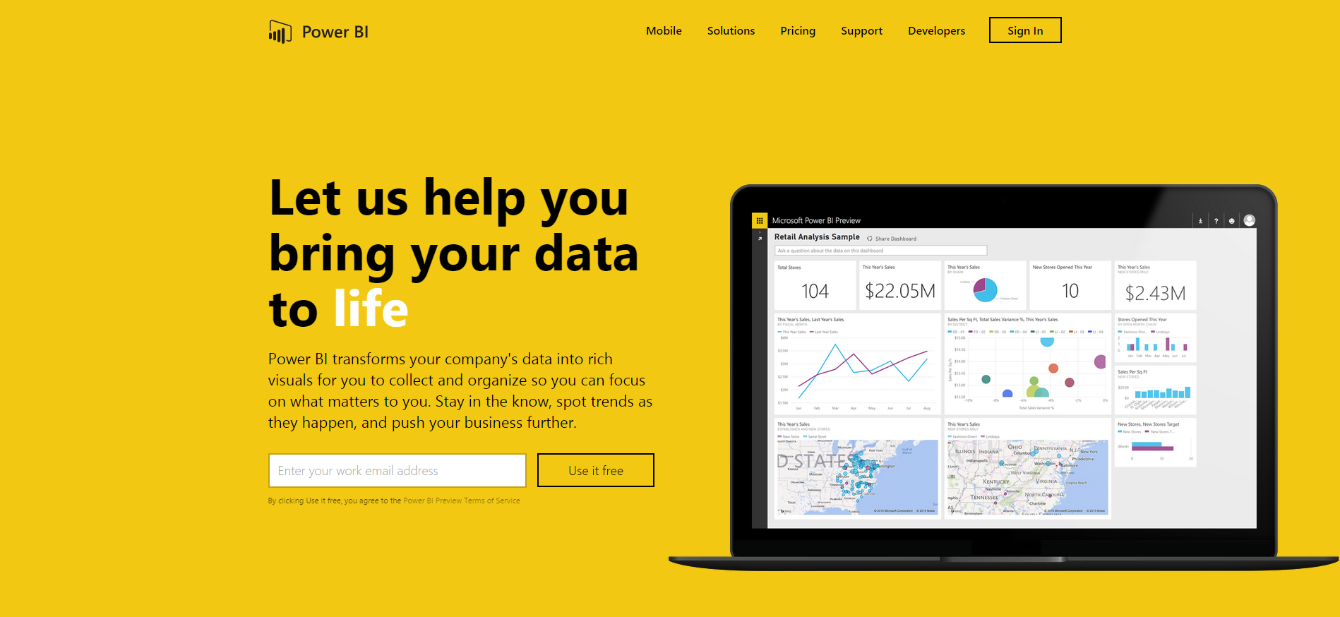
Thankyou for Coming to PowerBI
Sign up for a free Preview account
Take the Power BI Tour
Notes:
Thanks for taking the time to walk through the main capabilities of Power BI.
If you’re ready to start exploring what Power BI can do for you and your organization, please visit powerbi.com.

